Slide 1

Many Facets of Hardware Monitoring
Konstantin Selyunin
Stefan Jakšić
Vienna University of Technology
Austrian Institute of Technology
Joint work with: D.Nickovic, R.Grosu, E.Bartocci, T.Nguyen
Notes:
Good afternoon, my name is Stefan Jaksic, I am PhD researcher from Vienna, Austria, and my colleague Konstantin Selyunin and me will present our recent work.
This work is part of HARMONIA research project which focuses on hardware monitoring for automotive domain.

Slide 2
Motivation
Cyber Physical Systems
  Physical environment controlled by digital
  Why monitors for CPS in HW?
Tackling slow simulation issue
Detect property violation during CPS execution
We take three approaches:
  FPGA Qualitative STL Monitors
  FPGA Quantitative STL Monitors
  Monitors based on Neural Networks
Notes:
In CPS, physical behaviors are typically controlled by a digital controller. CPS exhibit complex behaviors that often combine discrete
and continuous dynamics. The complexity and heterogeneous nature makes their verification a difficult task.
We want to verify CPS using monitors implemented in Hardware.
Why – because we want to apply assertion based verification methods during CPS execution in realtime.
Our goal is to avoid using simulation testing which does not scale well due to immense computation requirements.
We choose Signal Temporal Logic as our property specification language, due to expressivness and formal semantics.
STL Monitors in FPGA
Shorten verification time
Automate the process
Quantitative Monitoring of STL Properties
More precise robustness degree
Online algorithm for robustness degree implementable in hardware
Neural HW Monitors
We are also interested in applying novel hardware architectures for building monitors. Recently IBM revealed a hardware-friendly spiking neural architecture called TrueNorth, and in this talk we show, how to use this model for buildingMTL monitors from TrueNorth neurons.

Slide 3
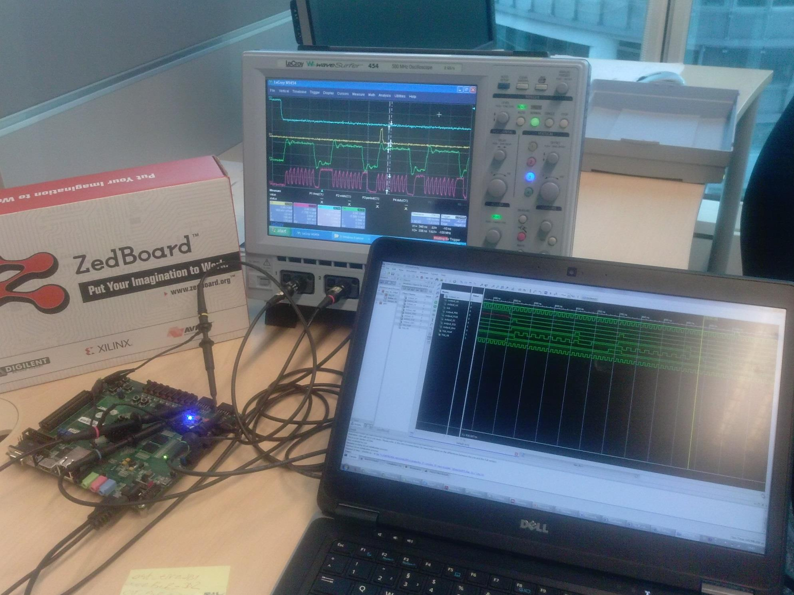
Qualitative STL Monitoring on FPGA
Notes:
In this picture we can basically see our goal – we want to build an automated way to generate hardware monitors for STL. They must
Monitor the device under test in an online fashion , during runtime. We want to have an error indication signal. Monitor does not interfere with the running system and does
not introduce any processing overhead to the running system. We adopt black box approach – the monitor is ignorant about the internal structure and functionality of the DUT.

Slide 4
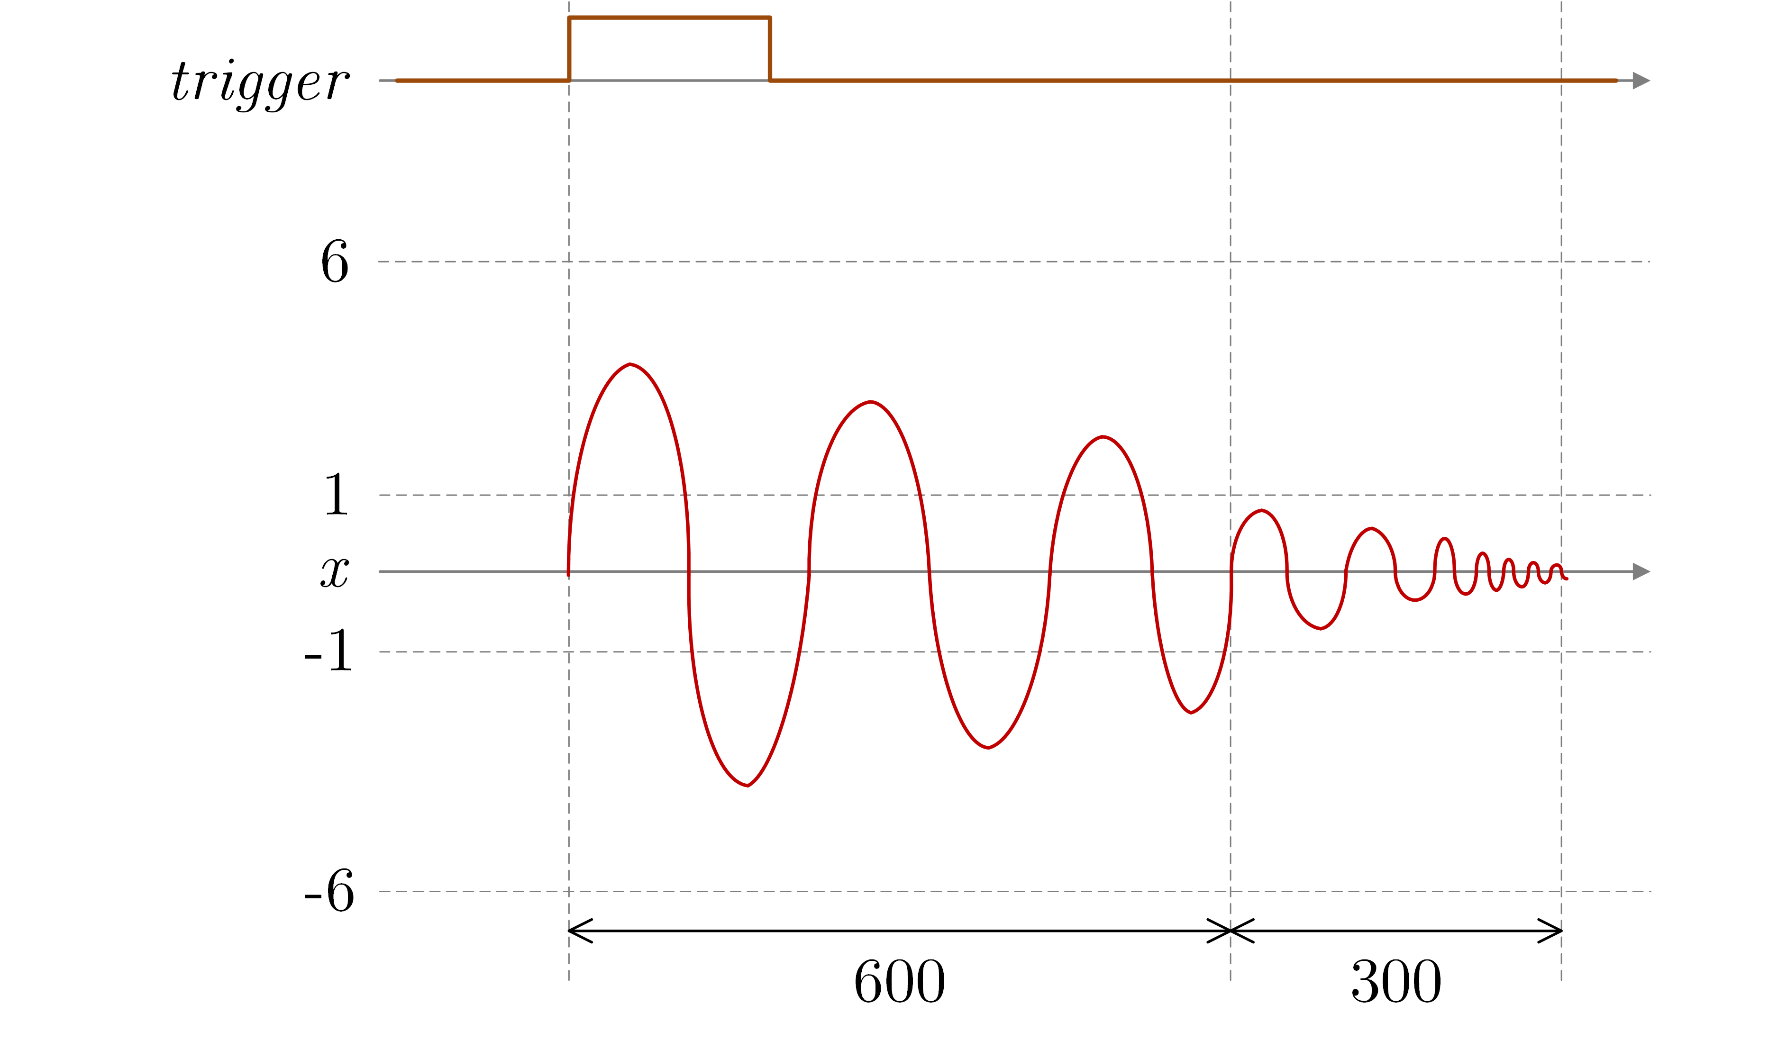
Bounded Stabilization – Formalization in STL
Specifications in Signal Temporal Logic
Signal must never
exceed +/- 6
“Bounded stabilization property: once trigger has risen, no later than 600 TU, signal must become stable and remain stable for at least 300 TU”
Formalized in STL:
Notes:
Let me briefly introduce STL by giving an example.
Signal Temporal Logic formulas can contain standard logic operators, time operators and real-valued predicates.
For signals In the picture we can define a bounded stabilization property: no later than 600 time units
after we see the trigger signal rising edge , analog signal must remain in specific amplitude range for at least certain period of time.
Based on the definition in natural language,we formalize the property in STL with the following formula:

Slide 5
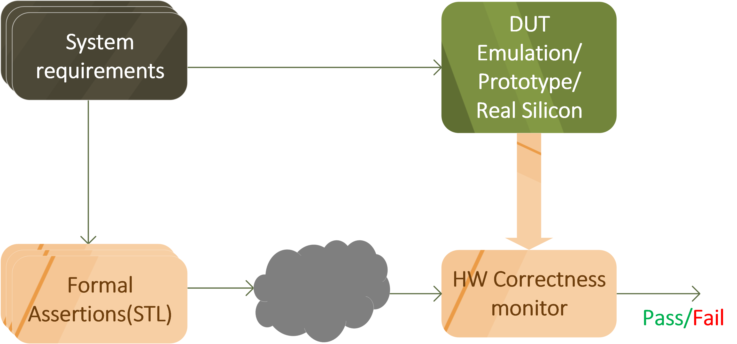
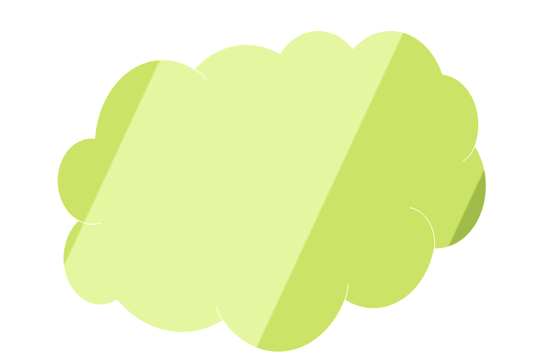
Overview
Code
generator
Challenges:
  Specification refers to past, present and future
  Runtime monitoring with limited computation and space resources
Notes:
We start with system requirements specification in natural language. The design team will use the specification to implement Device under test which can be an emulated device, a device prototype or a real silicon device.
On the other hand we will translate system requirements to formal assertions in STL. From there, we will use Code Generator, which
consists of several phases, in order to obtain STL property monitor implemented in HW. Then, we connect the monitor with the device
Under test and run the entire system. The monitor runs in parallel with the DUT and produces Pass-Fail verdict for the given property.
Our framework bridges the gap between formal assertions in STL and Hardware monitors.
We are faced with several challenges:
We have specification that contain past and future operators. Satisfaction of such formula depends on the future values.
Future operators introduce non-determinism.
STL allows time bounds on temporal operators. In order to evaluate such formulas it is necessary to buffer input signals for specified time.
However, FPGAs have limited computation and memory resources.

Slide 6
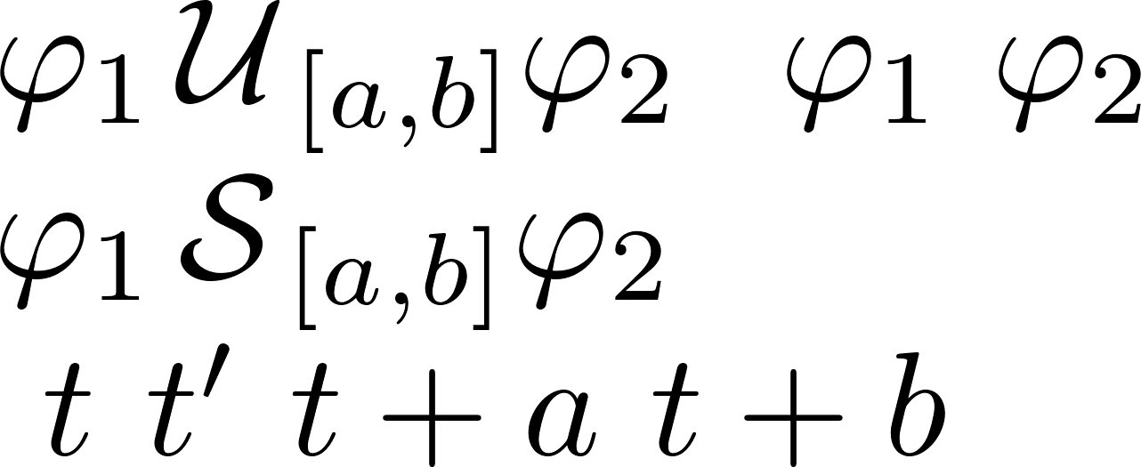
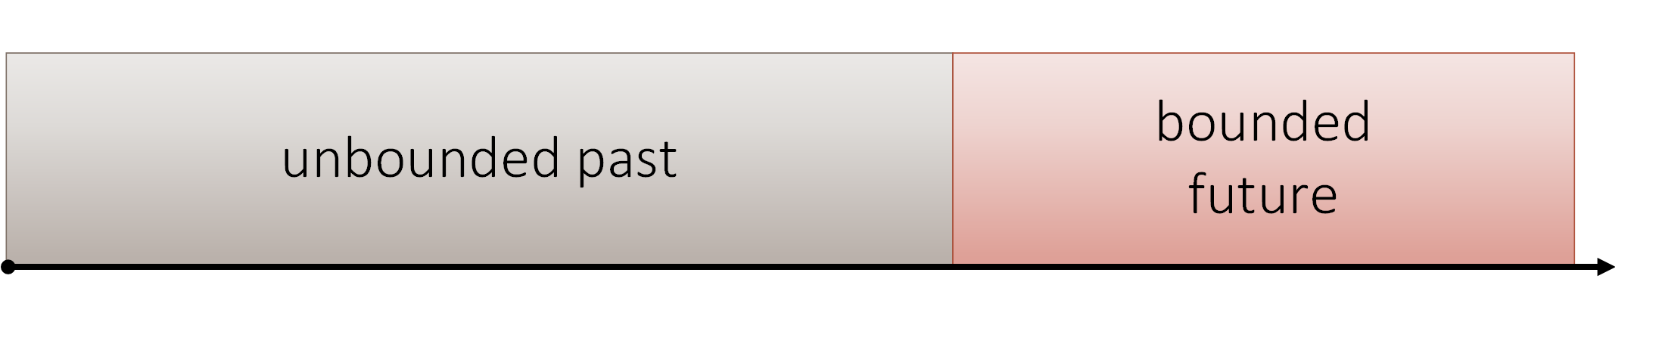
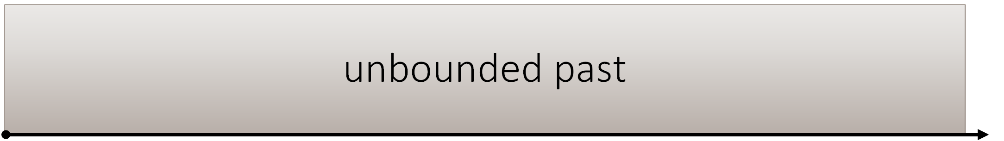

From Bounded Future to Past
More details can be found in:
  “From Signal Temporal Logic to FPGA Monitors” – MEMOCODE 2015
Notes:
Instead of evaluating a formula depending on the future, we aim to evaluate formula based on the past values only.
Let’s say we have a formula FI that depends both on the past and the future values. The future is bounded by the time horizon t+b.
Based on original formula FI, we create equisatisfiable formula PSI. FI is satisfied if and only if PSI is satisfied.
Instead of monitoring formula FI it is sufficient to monitor PSI and delay the verdict by b time units.
I presented only the concept here
Refer to the paper for more details
========================

Slide 7
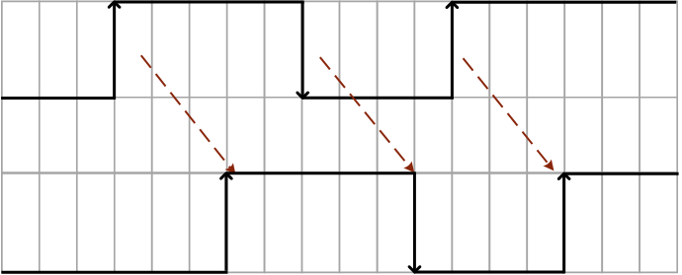
Reducing memory consumption
Low variability signals
Memory savings by buffering with counters
Notes:
Frequently we use STL formulas with time bounds. For this type of formulas we need to buffer signal values in order to evaluate them.
The naïve approach where we would sample the data on every clock tick would generate too much data to buffer.
For certain input signals we know that the signal change cannot occur faster than N time units after the previous change.
We call such property of a signal – a bounded variability. In this case, using buffering with registers connected in a cascade is not the optimal solution.
In case of bounded variability of an input signal, we use counters’ algorithm to perform buffering.
For every signal change we start a fresh counter. Whenever a counter expires , it means that a TUs have passed, and the signal change should affect the output.
In case that signal has low variability we can save a lot of space by using the counter algorithm.

Slide 8
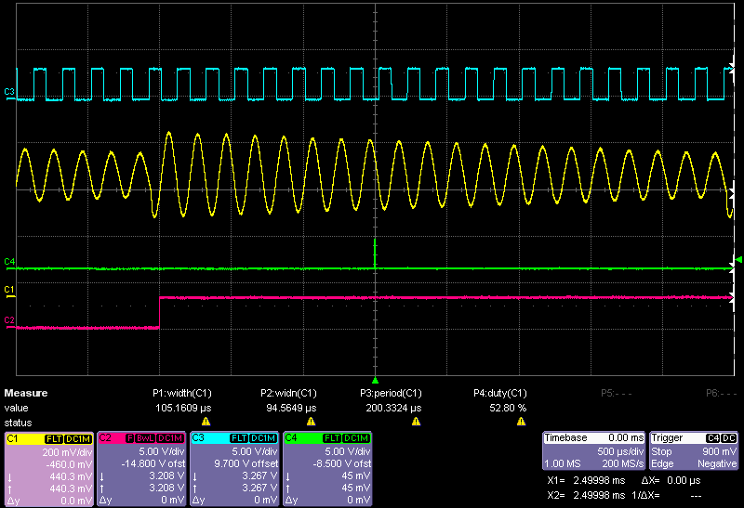
AMS Case Study: Stabilization
input < 0.5
analog_input
error
trigger
More details can be found in:
  “From Signal Temporal Logic to FPGA Monitors” – MEMOCODE 2015
Notes:
Here we can see the monitor for bounded stabilization working in practice.
The analog input signal oscillates with the trend to stabilize below a threshold of 0.5
However, the stabilization does not occur within the specified time bounds after the trigger signal rising edge and an error indication is fired by the monitor[GREEN SIGNAL].

Slide 9
Quantitative Monitoring of STL
Qualitative monitoring: pass/fail
Replace satisfaction relation with Robustness Degree
  Level of satisfaction/violation of formula
Ingredients:
  Distance Metric
  Algorithm for computing distance
  between a trace and a specification
Notes:
In its original form, STL allows to distinguish correct from incorrect behaviors.
However, the binary true/false classification
may not be sufficient for real-valued behaviors. In fact, CPS are often sensitive to small perturbations in initial conditions, system parameters
and the accuracy of sensors, which may influence the correctness of the verdict.
In order to address this problem, the satisfaction relation can be replaced by the robustness
degree [9,8,7] of a behavior with respect to a temporal specification. The robustness degree
gives a finer measure of how far is the behavior from satisfying or violating of the
specification.
We base our robustness degree on specific distance metrics we call Weighted Edit Distance.
We want to integrate our monitors into emulation based testbenches, therefore we need to implement them
in hardware. In order to do so we need to devise proper online algorithm for computing such distance between
observed signal trace and specification expressed by STL formula.

Slide 10
Weighted Edit Distance
Distance metric sensitive to both space and time discrepancies
  Skorokhod distance used for continuous signals
  Time distortion penalty < pointwise cost savings
  What about discrete signals?
Weighted Edit Distance
  Deletion, Insertion and Substitution
  Weighted substitution cost – ordered alphabets
  INS + DEL penalty < SUB cost
  Able to distinguish between space and time discrepancies
Notes:
We need distance measure
takes into account both space and time.
We were inspired by Skorokhod distance – this distance tries to minimize pointwise distance
between two signals by applying a continous bijective retiming function.
The Skorokhod distance definition minimizes pointwise distance, assuring it is less than the
Cost introduced by the distortion. In other words , penalty for introducing timing distortion
Must not override achieved cost savings in pointwise distance.
However, such distance is defined for continous signals.
We base our metrics on Weighted edit distance. We allow three operations on symbols INS, DEL, SUB.
Insert and delete operations assume insert/deleting a symbol from the input sequence, therefore affecting
Time domain as well. Substitutions simply replaces a symbol with another one, affecting only the value domain.
The value domain of digital signals is ordered. The substitution cost shall take into account the actual
Difference between signals‘ values.
The WED has similar concept like Skorokhod – it will try to minimize pointwise distance described by substitution costs, by
allowing time distortion operations INS/DEL. Like in Skorokhod, WED also
optimizes over time distortion cost. Penalty for using time distortion operations must be less than cost achieved using only substitution.
Let me justify why we defined the distance this way.
In case we have dominant differences in value(space) domain of two signals, the WED algorithm will predominantly decide to use
Substitution operations. Therefore the total distance will be the sum of the substitutions reflecting the space difference among signals.
This way we get more precise information on the space difference of signals than using other semantics based on propagating max pointwise distance value.
In a converse case, when we have two very similar signals shifted by a constant time delay, the WED algorithm will detect such situation, opting for fixed number of insertions and deletions. Therefore, the distance will be the sum of costs of inserts and delete operations which is constant wrt time delay. This distance measure reflects reality better than Humming distance which would accumulate substitution costs instead, leading us to conclusions the signals differ in space rather than time domain.
The Hamming and edit distance do not provide satisfactory solutions for comparing
digitized signals. Both distances are defined over unordered alphabets and associate
fixed costs to different kind of operations.
//////////////////////////
In contrast, the value domain of digital signals
is ordered despite being finite. The pointwise distance between two
discrete signals at a given time step shall take into account the actual difference between
the signals’ values. In addition, the Hamming distance provides only point by
point comparisons between sequences and consequently does not account for the potential
timing discrepancies in the sampled signals. In other words, two discrete signals
that describe the same behavior delayed by a constant time shift will typically have a
large Hamming distance. The edit distance addresses this problem by allowing us to
bridge the time shifts using insertion and deletion operations.

Slide 11
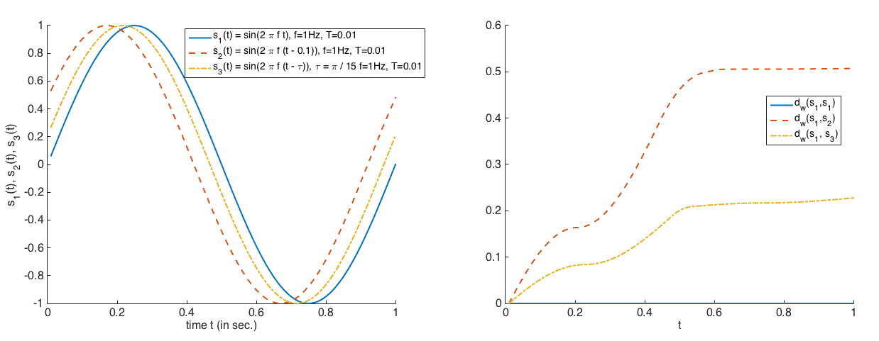
Weighted Edit Distance: time shift
WED does not accumulate cost in case of time shift
WED is aware of space differences as well
Notes:
We can see three sinusoidal signals on the left hand side with different constant time shifts.
We always calculate the distance from the blue colored signal. We can see that the distance
starts growing but after a specific point becomes constant. This is due to the WED algorithm
which finds the cheapest way to find a perfect match between the blue sinusoid and the shifted one.
The larger the time shift is present, the larger will be the absolute value of the distance.
In case we used Humming distance here, the distance would constantly grow over time, due to accumulation of substitutions cost.

Slide 12
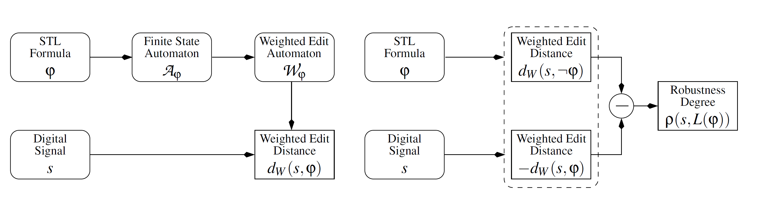
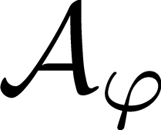
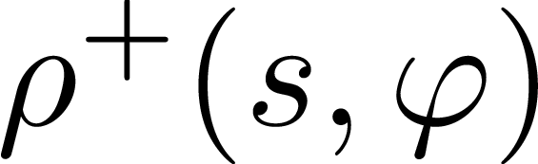
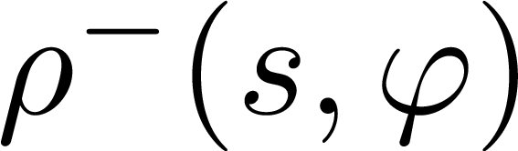
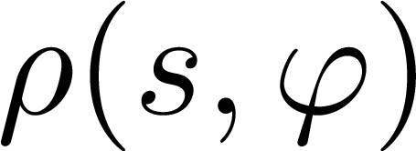
Computing Robustness based on WED
Positive Robustness – degree of SAT of
Negative Robustness – degree of UNSAT of
+ =
Notes:
We start with an arbitrary STL formula FI. Then we use on-the-fly tableau construction or temporal testers approach.
In next step we translate A FI to the weighted edit automaton W Fi. Due to the edit operations added, such an automaton can accept any sequence. Each accepting path induced by the signal
Corresponds to a sequence of weighted edit operations needed to transform the signal so that it belongs to the language of Automaton A FI. The value of the least expensive such path corresponds
To the weighted edit distance between the input signal and the spcecification.
WE introduce negative robustness as WED of the actual signal from the Language of formula FI. If formula is satisfied it is 0, otherwise it will have a negative value of WED.
Conversely, positive robustness is the WED of a specific trace from a Language of Formula NOT FI.
By summing the two we can obtain the actual robustness degree of a specific trace against a formula FI.

Slide 13
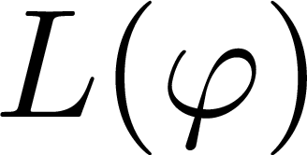
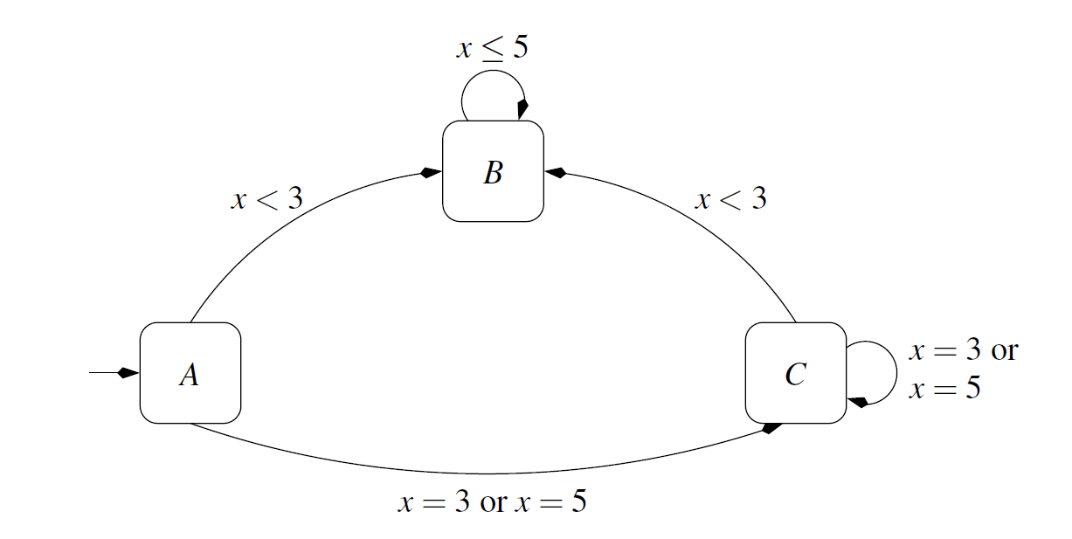
QM Example: Acceptor
Let’s consider the formula:
Acceptor for language
Notes:
This automaton accepts the language of formula Fi. All states are accepting. The value domain is limited between [0,5].
Non accepting state is not presented. The transitions are labeled only with legal conditions for taking a transition.
We work with symbolic automata – because we can have large allphabets.
For instance we see that if we observe any of the values 0,1,2 we get to a state where every sequence will get accepted.
OVBJASNI KAKO TRANSFORMISES JEDNU TRANZICIJU
ZA OPSEG x koji je dozvoljen tranzicijom SUB cost je 0.

Slide 14
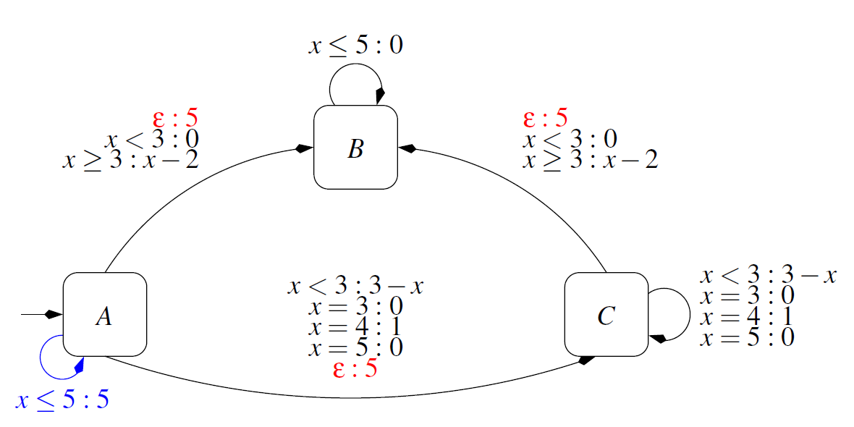
QM Example: Weighted Edit Automaton
Model substitutions by assigning input-dependent cost
Model deletions with self-transitions
Model insertions with ε-transitions
Notes:
Now we have an appropriate abstraction that will help us calculate robustness based on WED.
We add the following transitions:
We add the transitions modeling substitutions operations by extending the transition cost function for the existing transitions.
We add the self-transitions to each state to model delete operations, except in case it is redundant. Max cost.
We add EPSILON transitions. Such transitions do not consume a letter from an input, and take maximum cost, which is 5 in this case.
Deletions are redundant if a cheaper equivalent substitution transition already exists.
Every run of this automaton has a specific cost.
By traversing this structure for a specific input letter sequence, we can obtain the cost of a path to any of the accepting states.
Input letter specifies the exact cost of substitution operation that can be taken from a specific state.

Slide 15
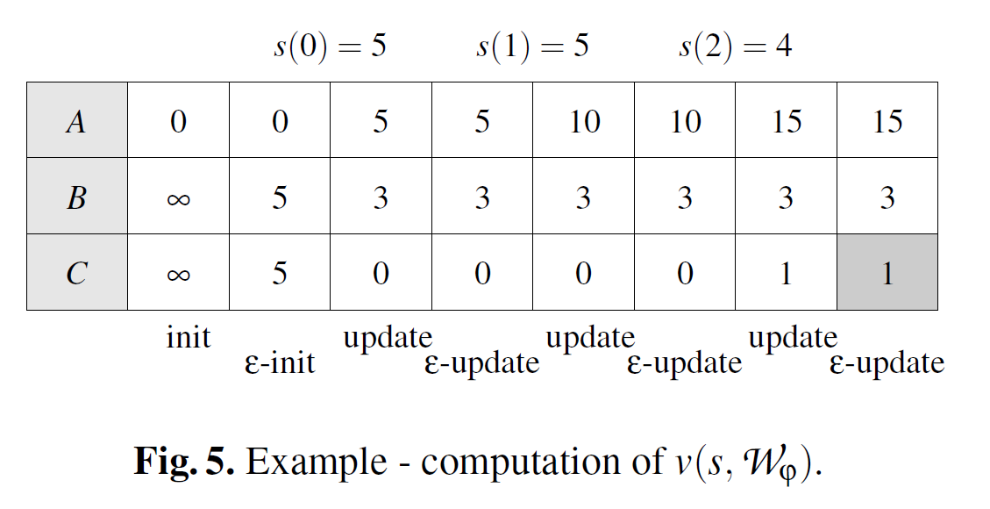
Algorithm for calculating WED
Dynamic programming
Admits HW implementation
Notes:
We now present an on the fly algorithm for computing weighted edit distance.
First we need to initialize the
In every step, the algorithm
reads one letter from the input sequence
calculates the distance to all the nodes of the Weighed Edit Automaton.
applies E-transitions in order to improve the obtained distances even more
We reduced the problem of calculating the distance between trace and a specification to finding the cheapest accepting path in Weighted edit automaton
for a given input sequence.

Slide 16
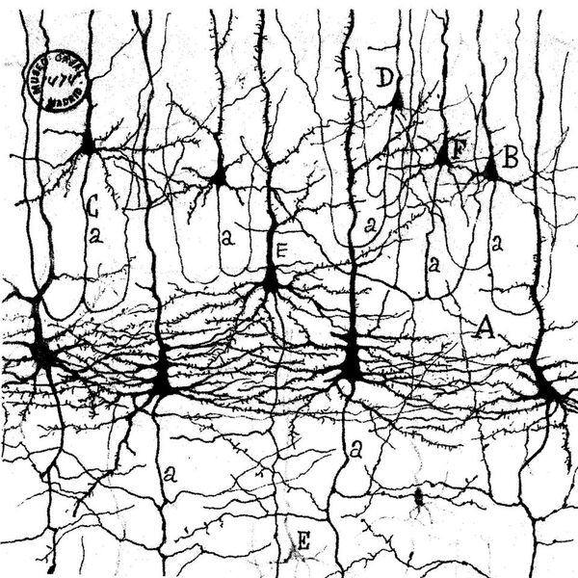

Neural Architectures for Monitoring
Neural models abstract important biological behaviors
Novel hardware architectures emerge based on these principles
Neurons in the mammalian cortex
observed under the microscope by
Ramon y Cajal (1909)
How to build monitors based on spiking hardware architectures?
TrueNorth's neurons to revolutionize system architecture (http://www.research.ibm.com/articles/brain-chip.shtml)

Slide 17
IBM’s TrueNorth Model
Extends Leaky Integrate and Fire model
  Synaptic Integration:
  Leak Integration:
  Threshold, Fire, Reset:
[Cassidy et.al. 2013]

Slide 18
Configuring Neurons to Recognize MTL Operators
Logical Operators with TrueNorth Neurons

Slide 19
Configuring Neurons to Recognize MTL Operators
Temporal Operators:
  Reset Mode 2
  Saturate
  Largest Negative Weight
[“Monitoring MTL Specifications with IBM’s Spiking Neural Model”, DATE’16]

Slide 20
High Level Synthesis for Hardware Implementation
Translates a C++ subset to synthesizable HDL
restriction!
Hardware specific datatypes
    doing things bit-precise ap_int<19>
Pragma optimization directives
    #pragma ARRAY_PARTITION FULL
Result: IP for integration with other tools

Slide 21
Case Study
From a System-Level Requirement to a Neural Monitor
When the missile received the launch enable signal, it must see the fire enable signal followed within the next four time points. After fire en has arrived, no detonation is allowed for the next five time points."
Simulation of the Neural Circuit:

Slide 22
Questions?
Thank you for your attention
Stefan.Jaksic.fl@ait.ac.at
konstantin.selyunin@tuwien.ac.at
http://harmonia-project.com/

Slide 23
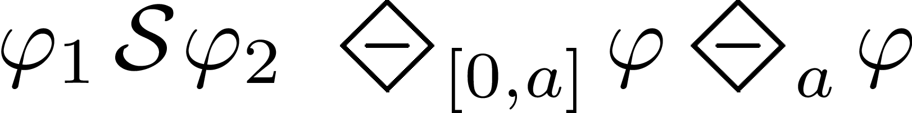
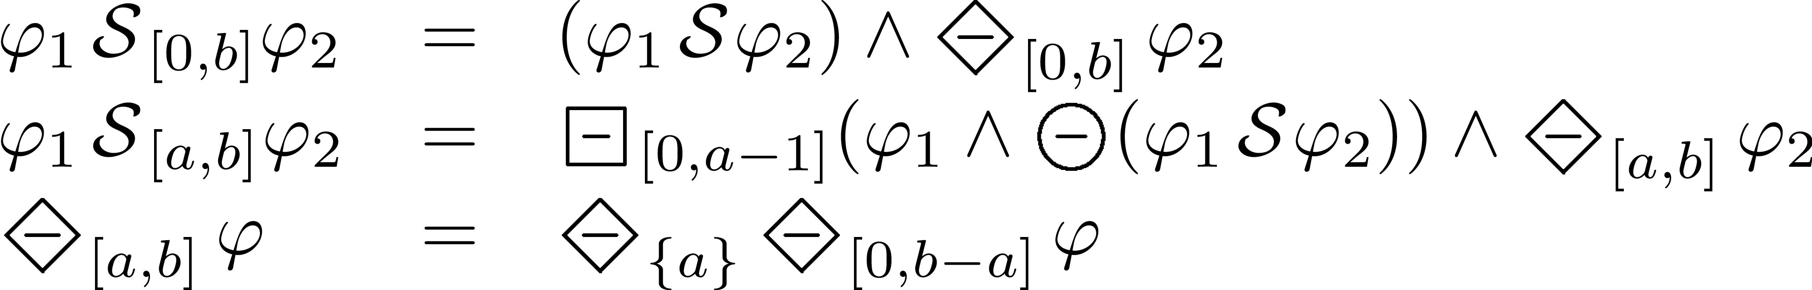
Simplifications
Simple past operators:
Since :
Once :
Notes:
So now we work with the formula containing only the past time operators. We have observed that there are STL operators that we know how to evaluate easily. Those operators are
The untimed since operator
Once in the past between zero and a
Once in a specific moment in past
Previous
For the ones that we do not know how to evaluate, we apply rewrite rules to reduce them to combination of expressions using basic past operators.
Therefore – we can evaluate every past time STL formula by knowing how to evaluate the basic past time operators.

Slide 24
From STL to FPGA Monitors - Challenges
STL Interpreted over discrete time
  FPGA implementation of STL monitors
STL with unbounded past and bounded future
Runtime monitoring with limited resources
  Speed and space
Real-valued predicates
Notes:
There are multiple challenges in implementing the monitors efficiently on FPGA.
First of all, STL was originally defined for continuous time model. However, Due to the fact that we want to see these monitors implemented of FPGA.
, we shall interpret STL formulas in discrete time.
Bounded future formulas satisfaction depends on the signal values that are unknown in the moment of evaluation. Such formulas introduce non-determinism.
Depending on the formula, a monitor for a property can take certain amount of memory on the FPGA which has limited resources.
Our goal is not to introduce any overhead that would affect the desired monitor operating frequency and to keep our monitors within FPGA space constraints.
We need to see how shall we treat the real valued predicates on FPGA.

Slide 25
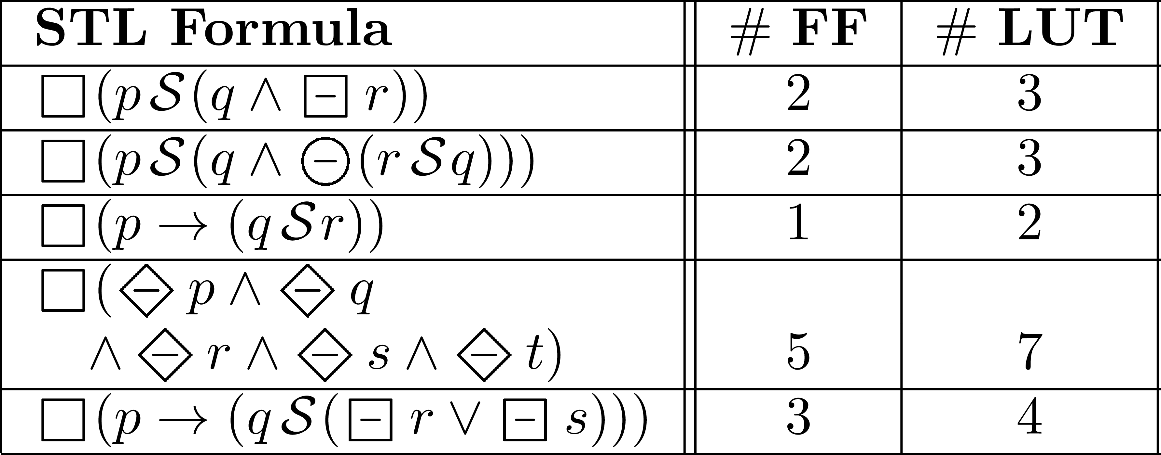
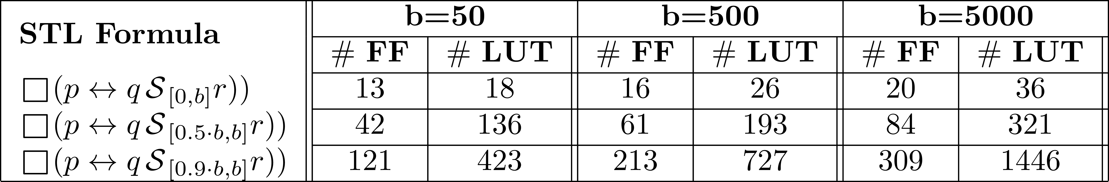
Evaluation
Untimed past STL
  Very small footprint
Past time scalability test:
  Variability influence
  Good scalability of “counters” algorithm
Notes:
For further evaluation, we performed several experiments. We generated the monitor for specific formulas in order to benchmark the resource consumption.
The first experiment was the evaluation of untimed formulas. We can see that even for the complex formulas we obtain a very small footprint in hardware.
The second experiment exposes resource consumption of our counters algorithm. On the vertical axis, we scale the input signal variability.
On the horizontal axis, we increase the time bound by an order of magnitude.
The results prove the expectations: As the signal variabilty increases the resource consumption grows. If we increase the time bound , the consumed resources also increase, however much better than the naïve approach which had a linear increase with the value of time bounds B.
<<<<STATE THE NUMBER OF RESOURCES ON ZED BOARD AND STATE THE MAXIMAL RESOURCES AVAILABLE ON THE MARKET AS A REFERENCE!!!!>>>

Slide 26
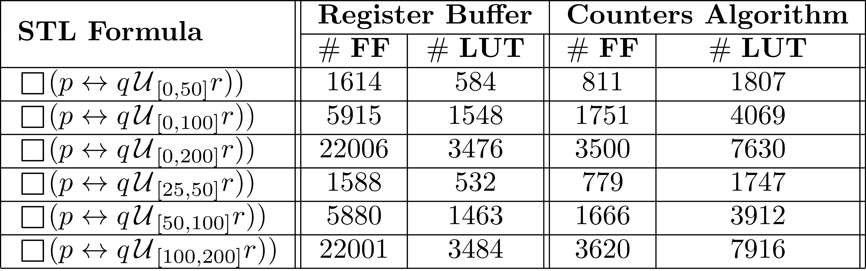
Evaluation
Bounded future STL
  Naive approach vs. Counters algorithm
Future can be costly
Notes:
The last benchmark performed was the one related to bounded future formulas. As we said previously, the future time formulas introduce non-determinism, and take a lot of resources in order to evaluate.
Here we wanted to compare the counters algorithm with the naïve approach of buffering using registers.
What we can see is that the resource consumption grows very fast, as we increase the time bounds. However if we apply counters algorithm, we obtain better scalability, although more lookup tables are consumed. This is due to the arithmetical operations applied on the counters.

Slide 27
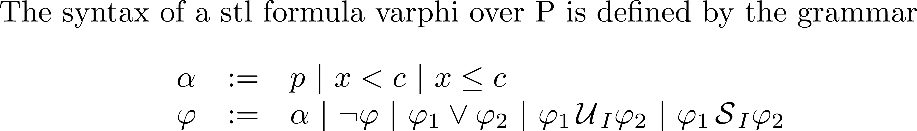
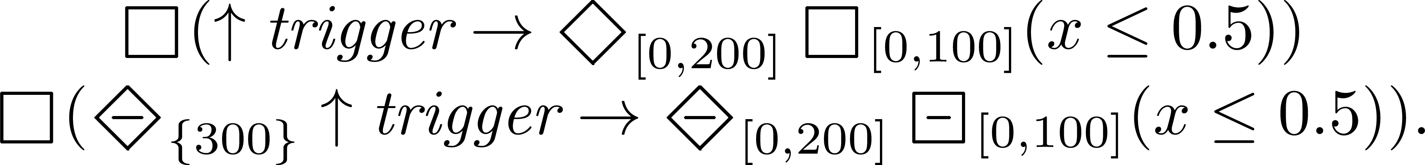

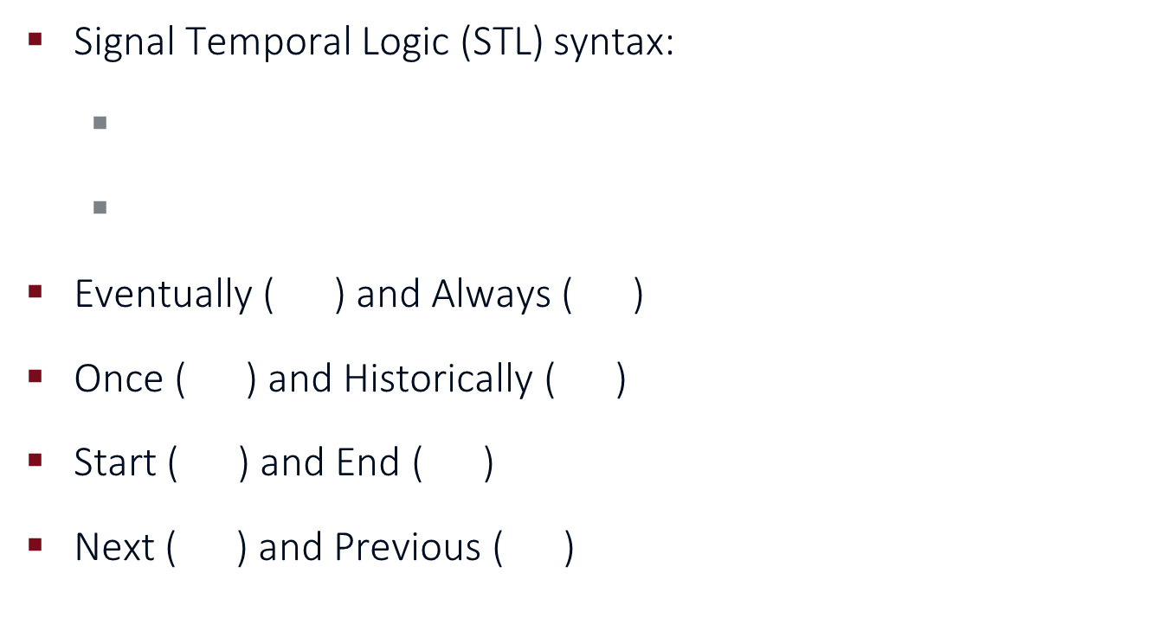
Assertion Language
Signal Temporal Logic (STL) syntax:
Eventually ( ) and Always ( )
Once ( ) and Historically ( )
Start ( ) and End ( )
Next ( ) and Previous ( )
Notes:
The assertion language we choose for our properties is the Signal Temporal Logic.
It is a specification language based on temporal logic
It allows
Real-time properties over digital and analog signals
It supports:
1.Numerical predicates
2.Standard logic operators
3.Temporal operators
Using the basic syntax, we can also define additional operators such as
Future time operators Eventually and always in the future
Past time operators: once in the past, and historically in the past
Start which corresponds to signal rising edge event. Conversely, End corresponds to falling edge event
Next and Previous which tester output depends on the formula value in next or previous Time Unit, respectively
STL allows automation of verification tasks due to its formal semantics(precise,rigourous)

